Slide 1

StayAwake
Capstone Project Phase B
Driver Drowsiness Detection system
Supervisor: Aliza Attaly
Students:
Dvir Ben-Simon
Arik Zagdon
1

Slide 2
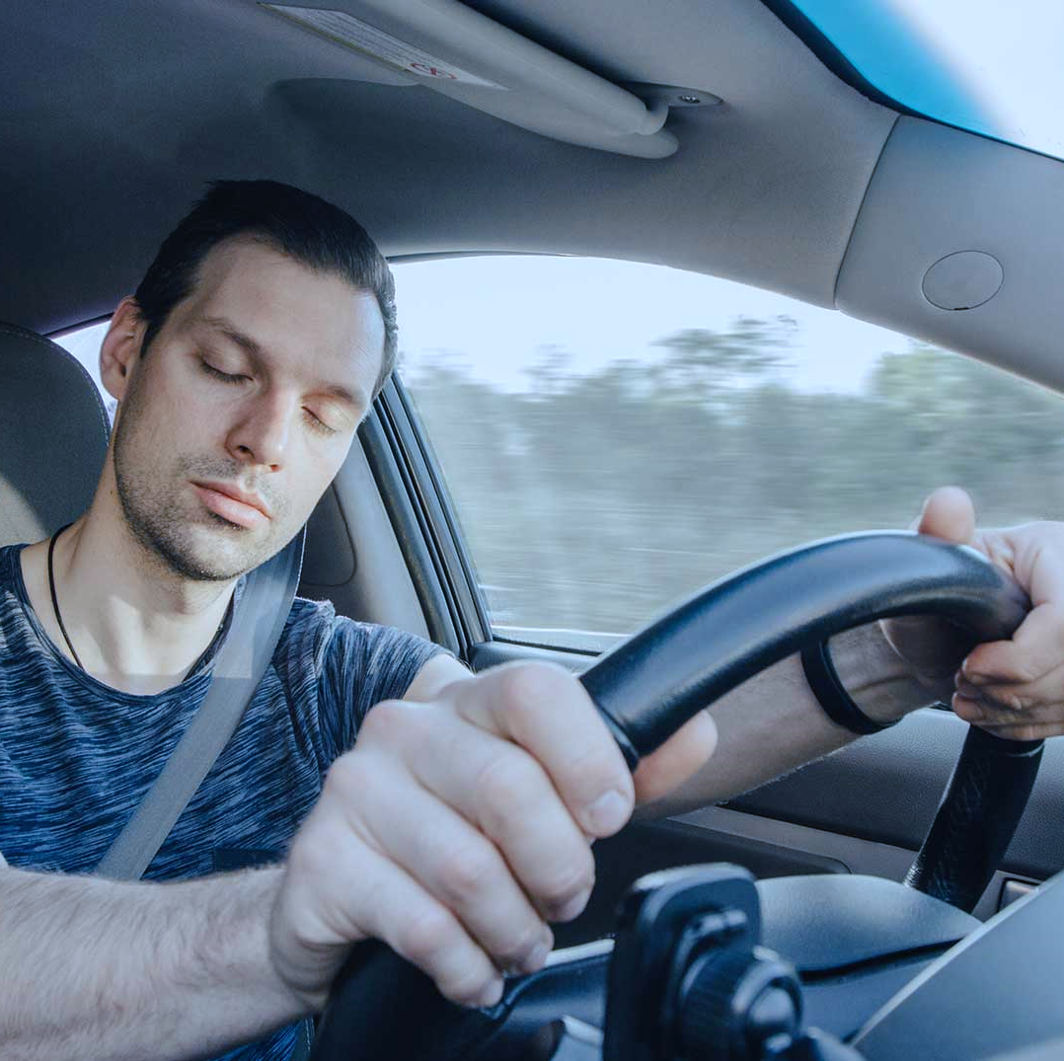
Introduction
Describe the need for the system
2

Slide 3
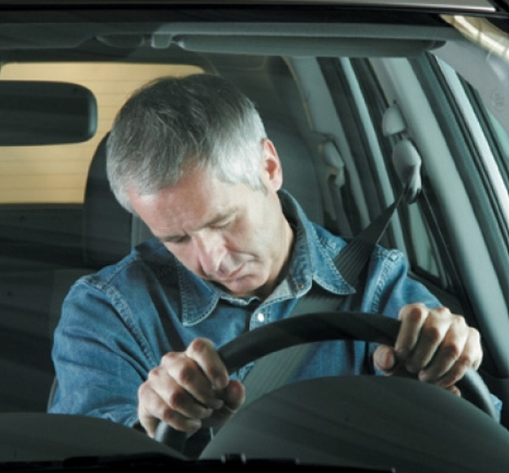
Drowsy driving responsible for about 100,000 crashes and 71,000 injuries every year
27% of the drivers admit that they are driving while being tired
3

Slide 4
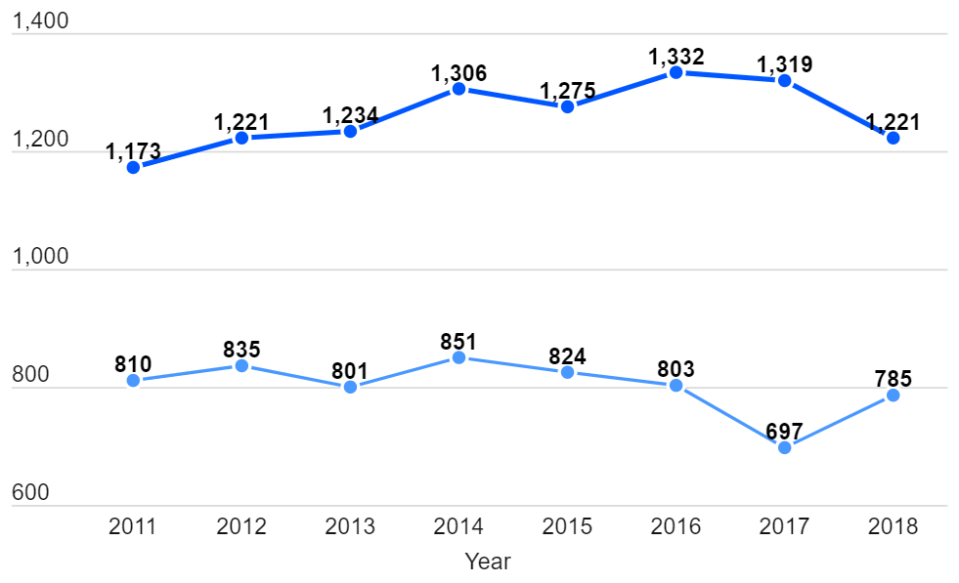
Statistics
Drowsy Drivers involved in fatal crashes
Fatalities caused by drowsy drivers
4

Slide 5
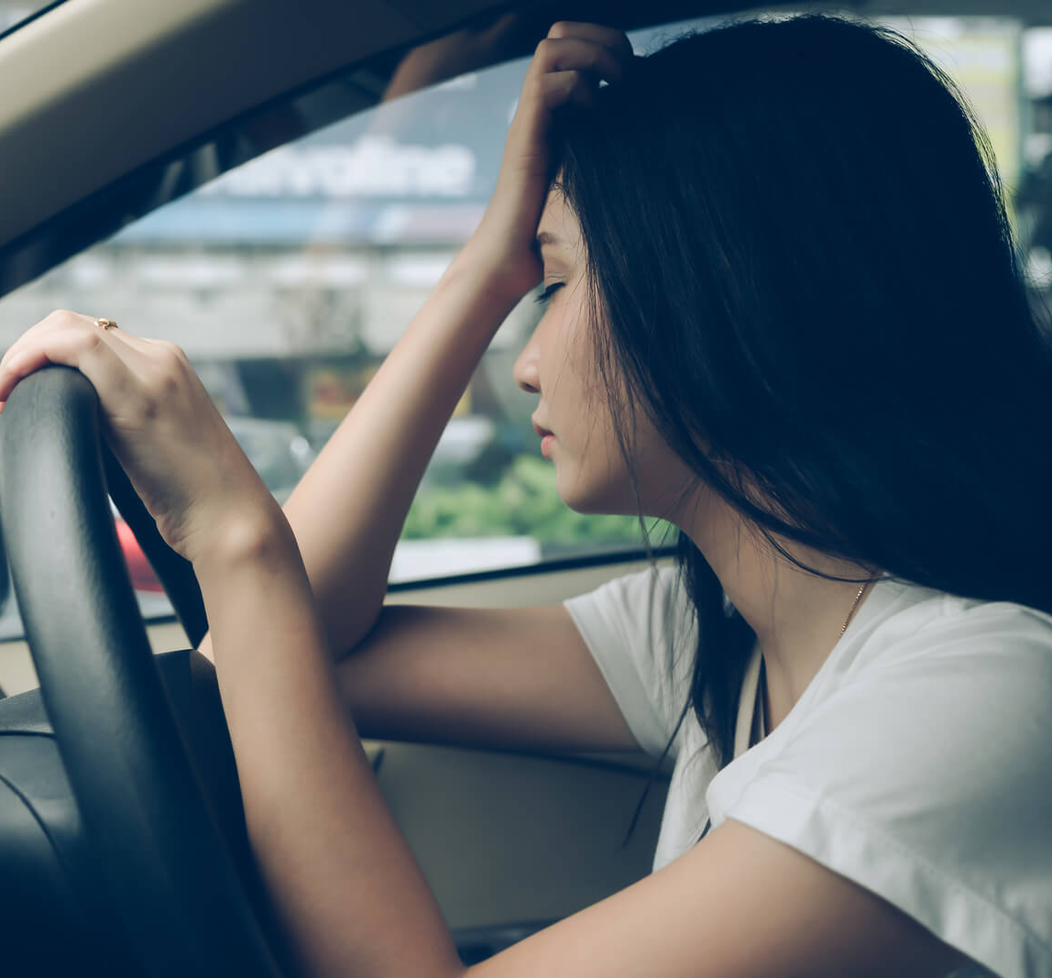
What are the signs of drowsy driving?
Constant blinking
frequent yawning
Long blinking duration (snooze)
Having trouble keeping your head up
Weaving between lanes
5

Slide 6
Development Process
6

Slide 7
Project Start,
phase A
Research
Design & Architecture
Development
Verification
Implement the
solution in python
Brainstorm,
Select project
UML Diagrams, define which technologies to work with
Investigate drowsiness detection projects
7

Slide 8
StayAwake System
Driver drowsiness detection
8

Slide 9
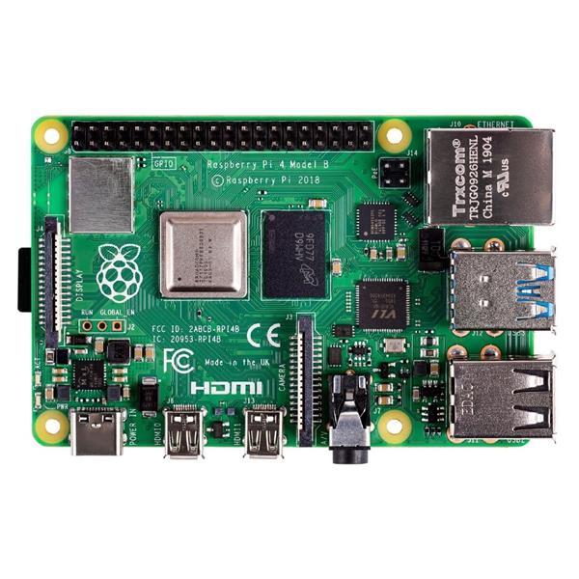
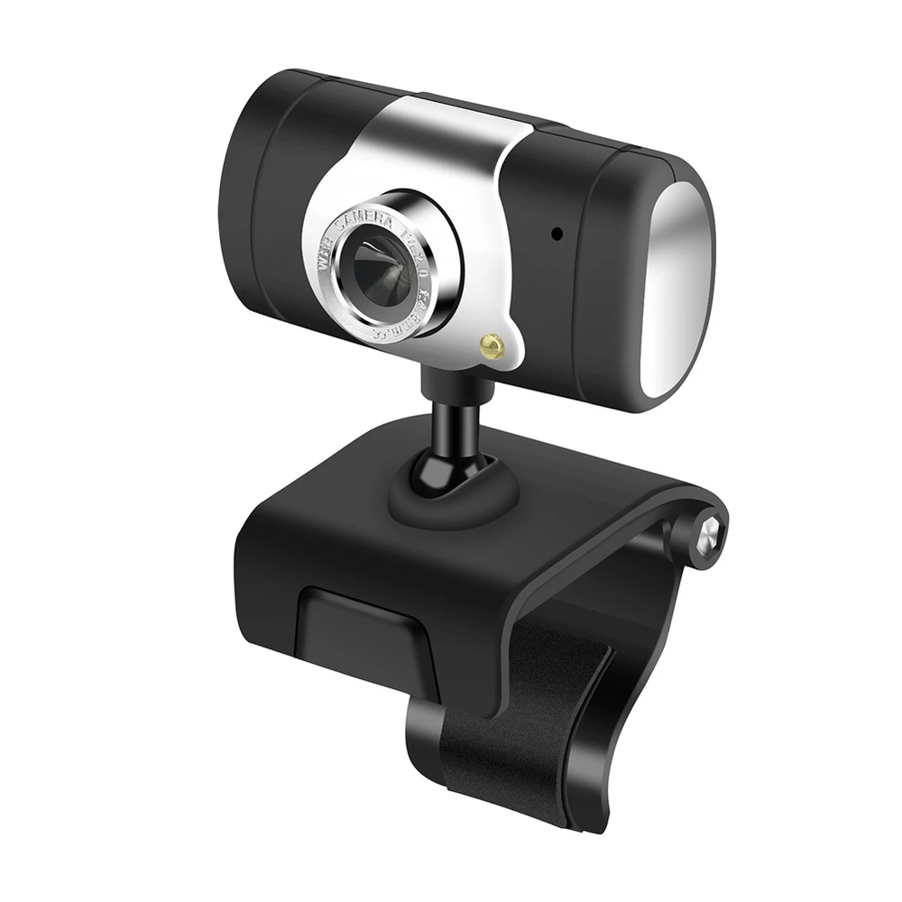
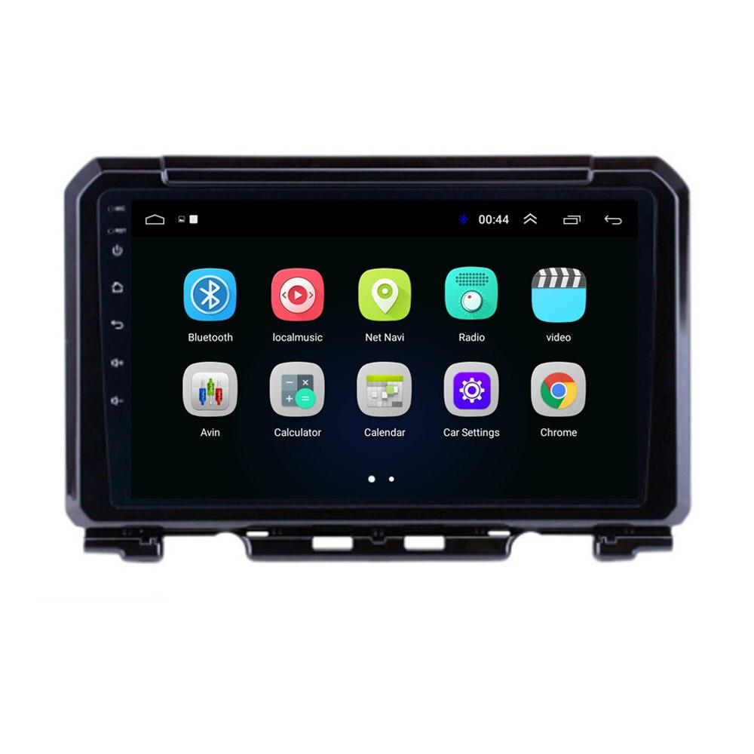
System Hardware Components
Mini-PC
Camera
Monitor
9

Slide 10
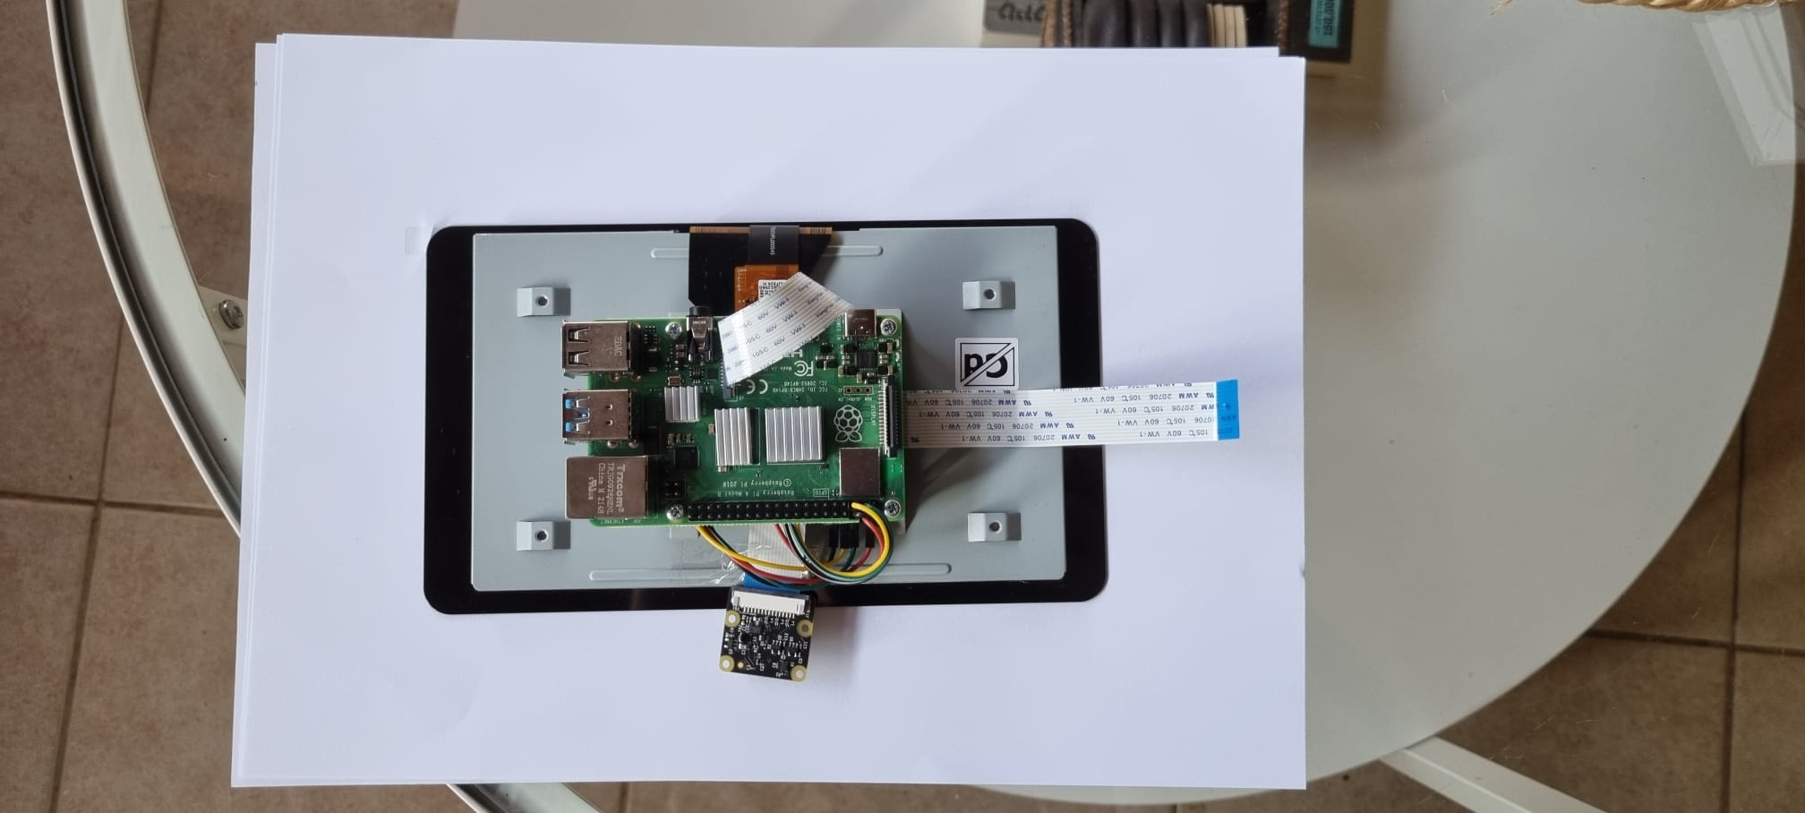
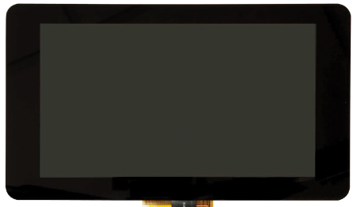
System Hardware Components
System Assembled
10

Slide 11
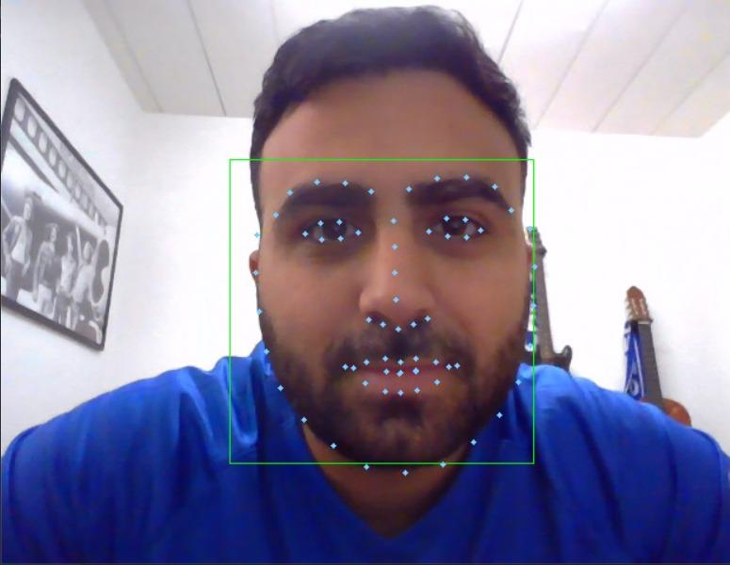
System Software
How does it work?
Face detection and point landmark extraction using Dlib library, giving us 68 landmark points of the face
11

Slide 12
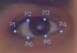
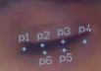
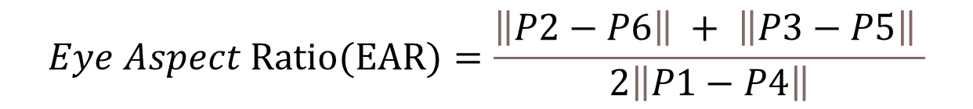
System Software
How does it work?
Closed Eye detection
Average EAR from both eyes
12

Slide 13
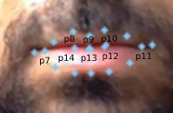
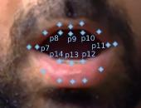
System Software
How does it work?
Open Mouth Detection
13

Slide 14
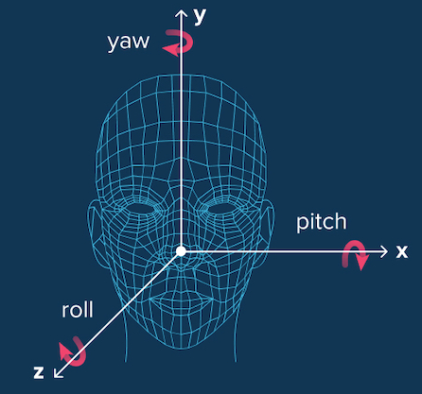
System Software
How does it work?
Head Pose Detection
14

Slide 15
StayAwake System
Driver fatigue analyzation
Hazard mode
Eye closed
Head fallen
Blinks per minute
Yawning
Snooze
15

Slide 16
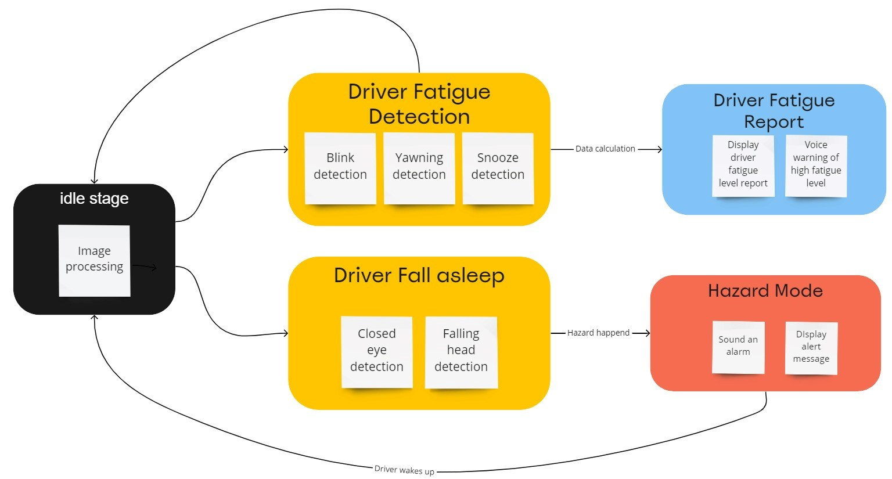
StayAwake System
16

Slide 17
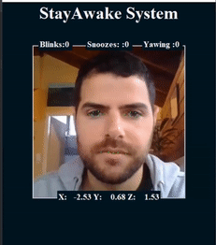
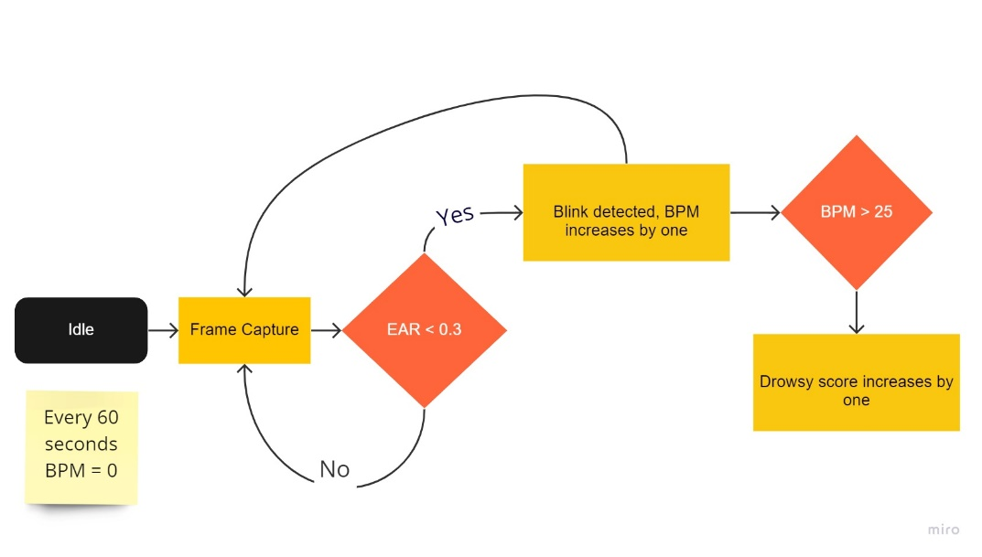
Driver fatigue analyzation
Blinks per minute
Count the number of detected blinks per minute, using the eye aspect ratio calculated in each frame. The EAR should be below 0.2 and blink duration between 50 ms to 150 ms
If the blinks per minute exceed 25 blinks, it add a fatigue sign to drowsy indicator variable
< 0.19
17

Slide 18
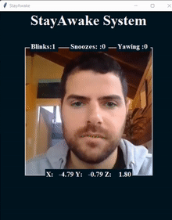
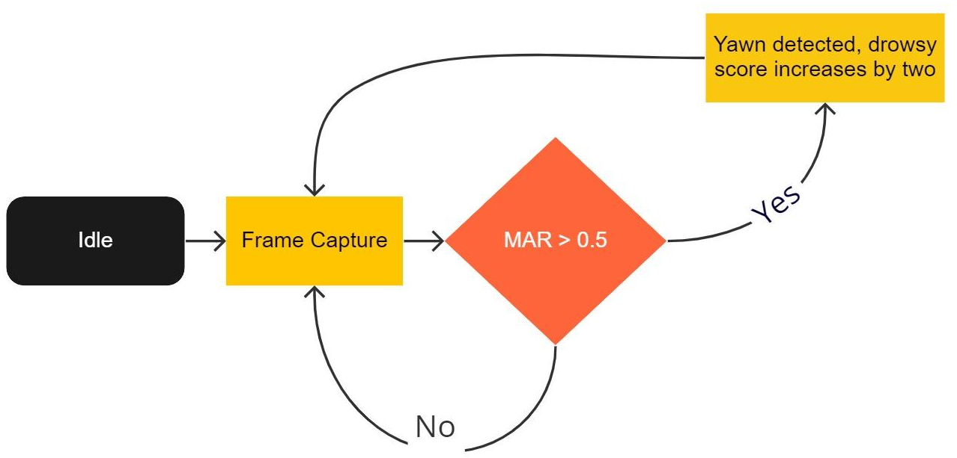
Driver fatigue analyzation
Yawning
Detect yaw using mouth aspect ratio that calculated in each frame The MAR should be higher than 0.2
If yawning is occurred, It add to the drowsy indicator variable
0.2
18

Slide 19
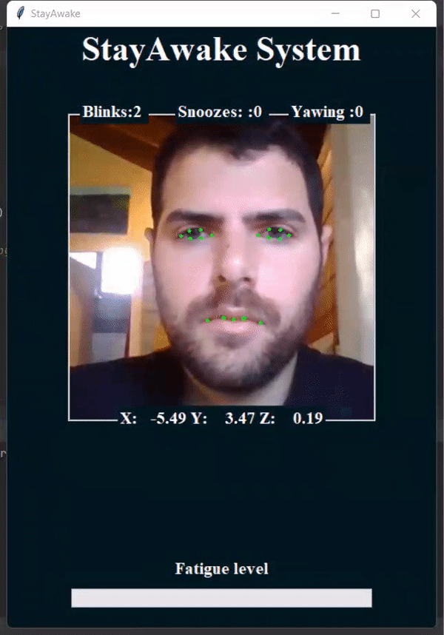
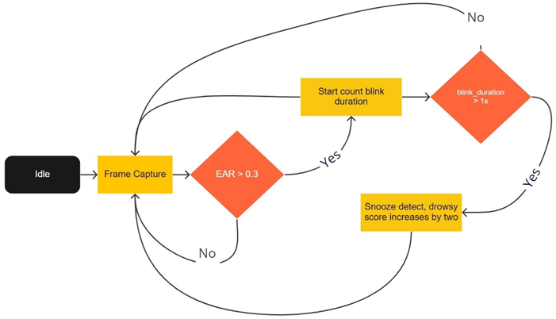
Driver fatigue analyzation
Snooze
Detect snooze using eye aspect ratio that calculated in each frame and blink duration. The EAR should be below 0.2 and blink duration between 150 ms to 500ms
If snooze is occurred, It add to the drowsy indicator variable
blink
0.15<duration<0.5
< 0.19
19

Slide 20
Driver fatigue analyzation
Feature Score | Trigger
Risky blinks (B) | BPM > 25
Yawning (Y) | Yaw detected
Snooze (S) | 0.15s < Blink duration > 0.5s
This three features counted during five minutes time window, and when time windows is ended the system calculate driver drowsy indicator by the follow formula:
Every time window, if the drowsy indicator is exceed 10, the fatigue level is increased by one, and appropriate message is displayed and sounded to the driver
The system have 5 different fatigue level, and every fatigue level has a different message.
20

Slide 21
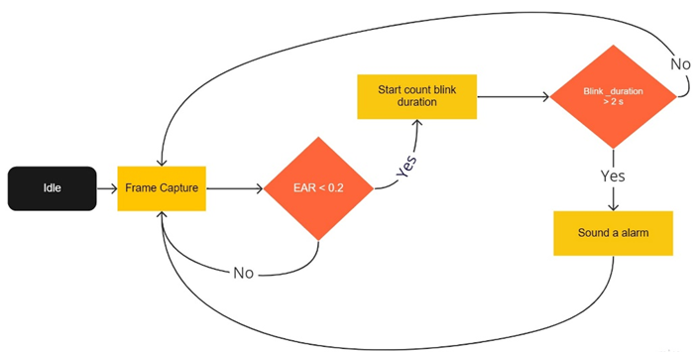
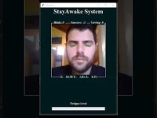
Hazard Mode
Eye closed
Detect if the eye closed for more than 500 milisecond
Sound noisy alarm in order to wake the driver up
Blink_duration>0.5
< 0.19
21

Slide 22
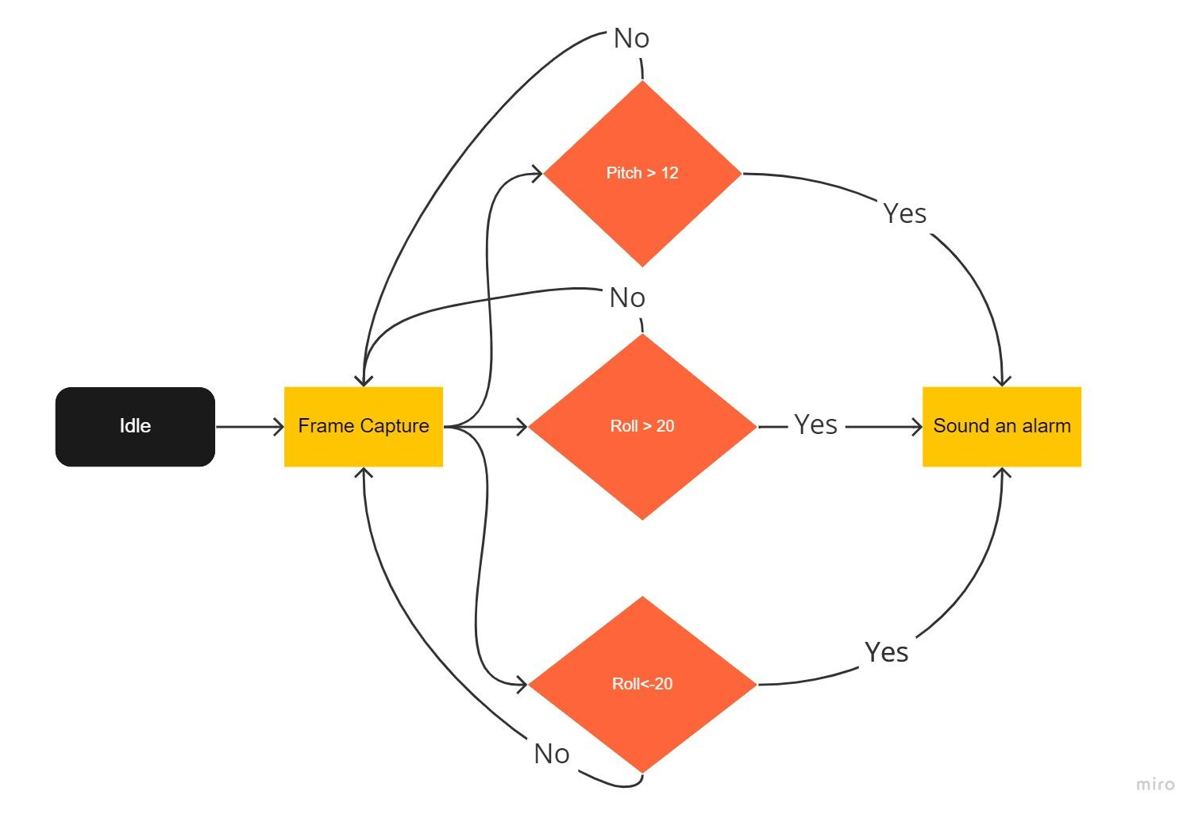
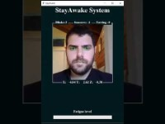
Hazard Mode
Falling head
Detect if the head angle dedicated as fallen
Sound noisy alarm in order to wake the driver up
22

Slide 23
Project Diagram
23

Slide 24
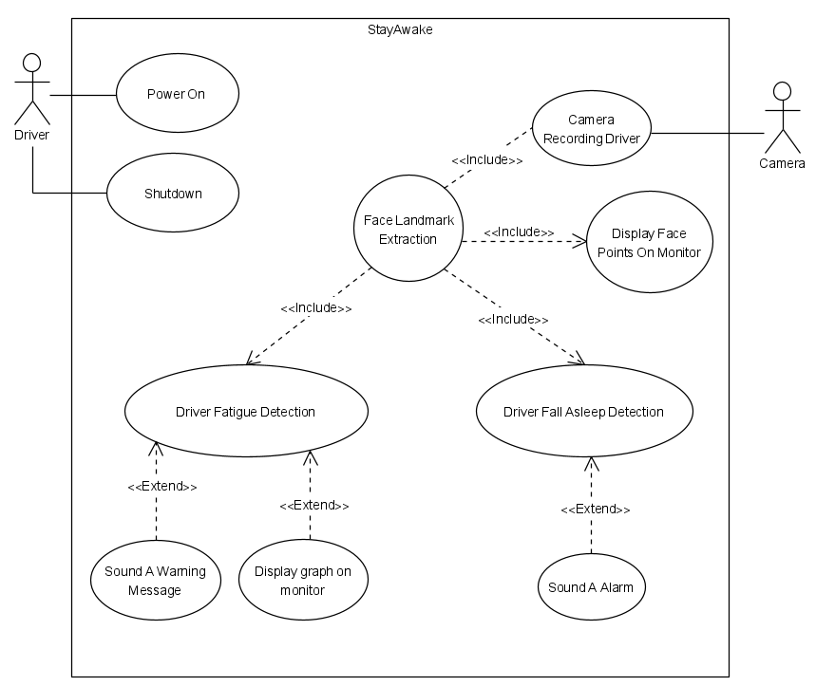
Use Case
Display Message on monitor
24

Slide 25
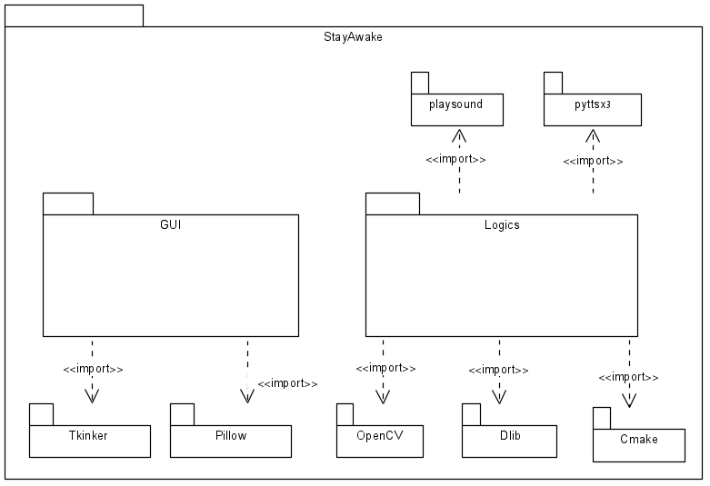
Package Diagram
25

Slide 26
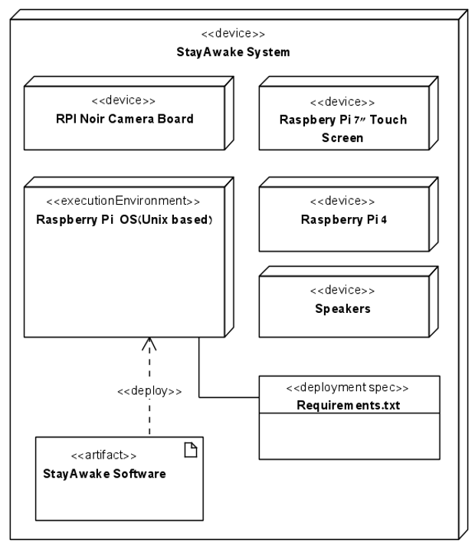
Deployment
26

Slide 27
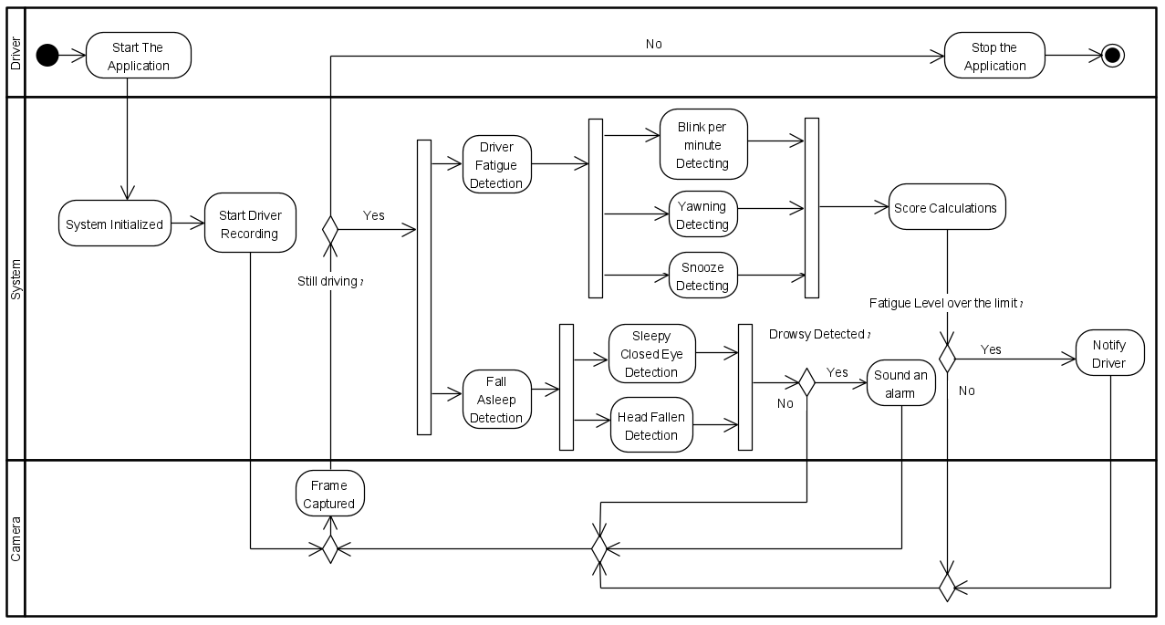
Activity Diagram
27

Slide 28
Project Evaluation
28

Slide 29
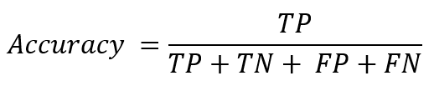
We calculated the confusion matrix with the parameters describe below, in order to measure the effectiveness of the system.
True Positive - The driver doing drowsy feature and the system recognized it
True Negative - The driver didn’t do drowsy feature and the system didn’t recognized it
False Positive - The driver didn’t do drowsy feature but the system recognized it as a drowsy feature.
False Negative - The driver doing drowsy feature and the system didn’t recognized it as a drowsy feature
In our project we used accuracy evaluation
29

Slide 30
Experiment & Result
30

Slide 31
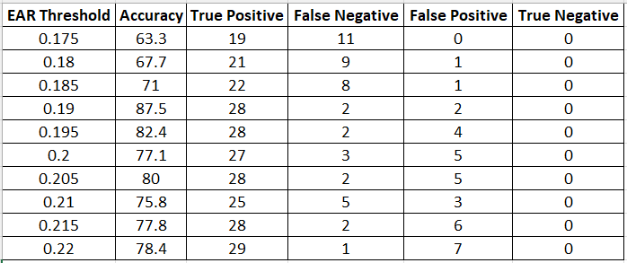
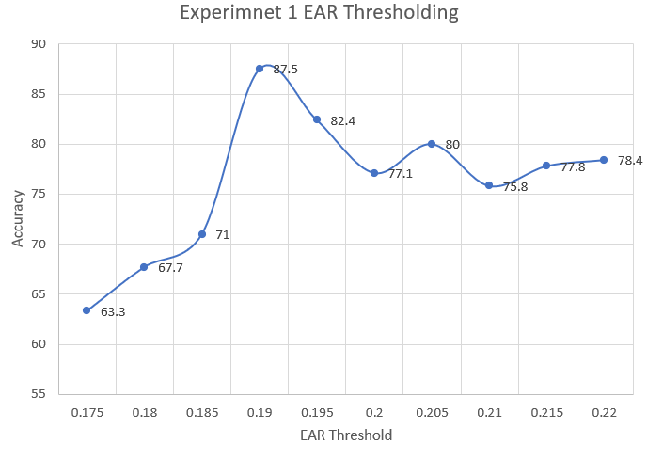
Experiment 1: EAR Thresholding
31

Slide 32
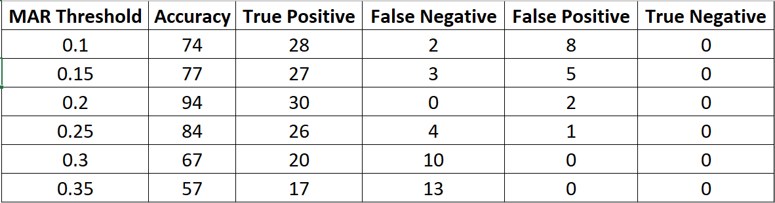
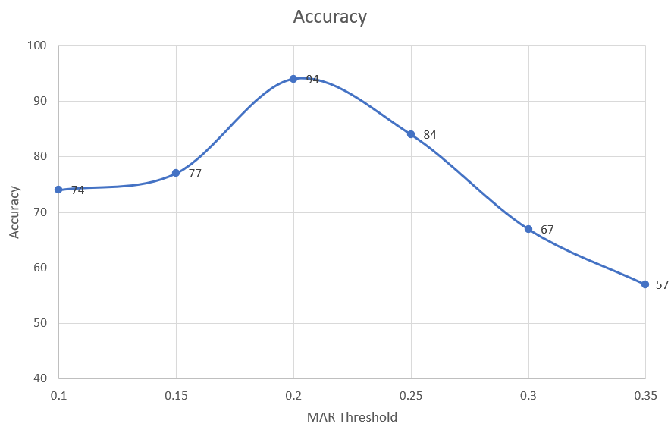
Experiment 2: MAR Thresholding
32

Slide 33
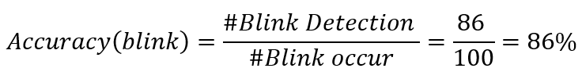
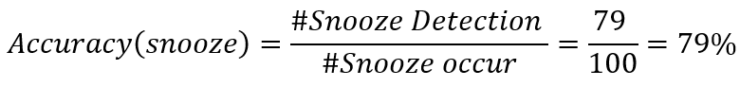
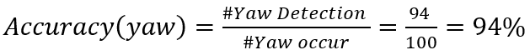
Results
We test all of the features of our system accuracy.
We did 100 times of evry feature.
Drowsiness detection
33

Slide 34
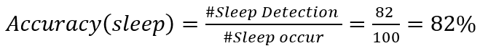
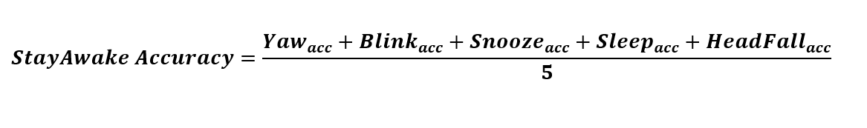
Results
Sleep detection
The total accuracy of the system is calculated as the average of all features accuracy:
34

Slide 35
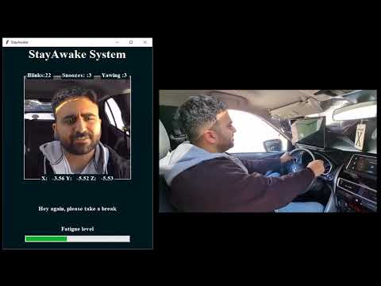
Demonstration
35

Slide 36
Challenges & Conclusions
36

Slide 37
Challenges
We got poor performance when debugging the first version of our software on the raspberry pi, because of high image processing stages.
When the driver blinked the system counted more than one blink, because of the system take account each frame below the threshold as a blink.
When the system sound an alarm or notifications the all system freezes until the sound is over, this issue stop the recognition process.
37

Slide 38
Conclusions
The system can avoid car accident causing of drowsy driver
Put more effort into the face recognition field, to increase the system’s performance and accuracy
Experiment the hardware specification in advance, especially in image processing systems
38

Slide 39
Thank You
39

